Slide 1
Line Angle Sensor Design

Slide 2
Outline
System Overview
Pivot Arm and Lower Pivot
Upper Pivot

Slide 3
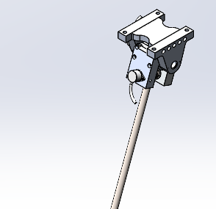
System Overview
2 Nested Axes
Renishaw RM22 13 bit encoders
Mass ~ 7.4 lbs
Reduced to 5.3 lbs
All from rotational mass (4.4 lbs to 2.2 lbs).
Inertia about the rotational axis reduced
33.04 lb in^2 vs 152 lb in^2
Achieved by changing rod to PEEK.
Investigating use of Carbon rod instead.
Carbon will degrade in the presence of chlorine. Likely will get several test days at minimum before it becomes an issue.
High stiffness when compared to plastic options.

Slide 4
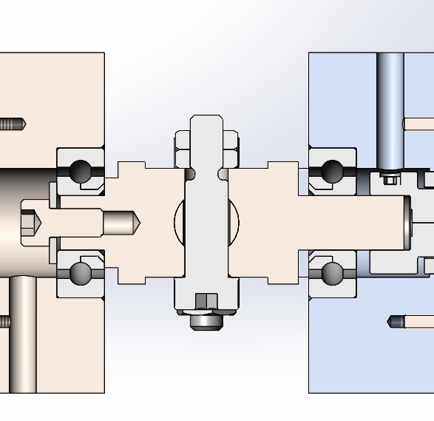
Lower Pivot and Arm
316 side braces, PEEK or Carbon tether arm.
Bearings are Acetal raceway with 316 balls
Low strength and speed, but high corrosion resistance.
Potential improvement if transitioned to ceramic bearings, but high cost.
Bearings rated to 30 lbf static, 50 lbf dynamic.
Design preloads the pivot on arm against the passive side of the assembly.

Slide 5
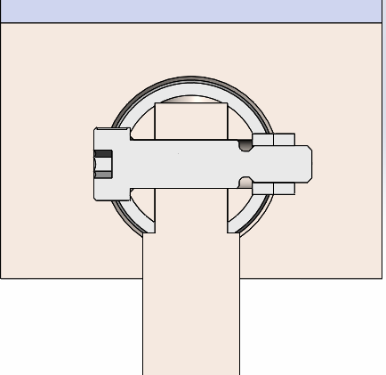
Lower Pivot and Arm
Tether Arm is attached to the pivot using a 1/8” 316 shoulder bolt cross-drilled through the pivot and the arm.
Reliably and repeatably attach the arm and the pivot.
Similar method is used at the far end of the tether arm to attach the tether guide.

Slide 6
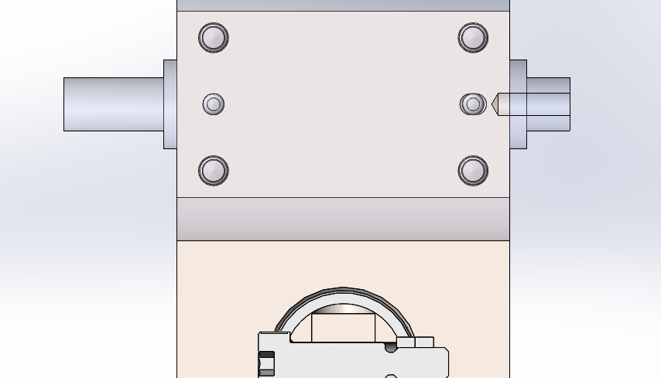
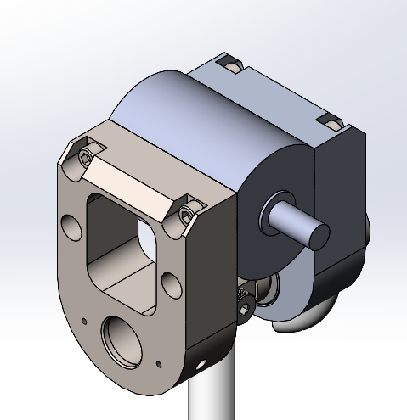
Lower Pivot Joint
Each half of the pivot joint is attached to the pivot for the upper axis.
Lightening holes present to minimize rotating mass.
Single piece manufactured from 316.
Doweled in place with 316 dowels.
Doweled on one side

Slide 7
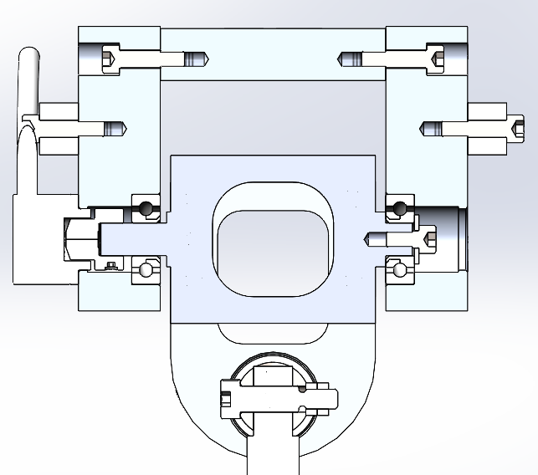
Upper Pivot
Anode
Same bearing layout as lower pivot arm.
Drilled and tapped holes for attaching an aluminum anode on each side.
Center Pivot hollowed out to reduce inertia.

Slide 8
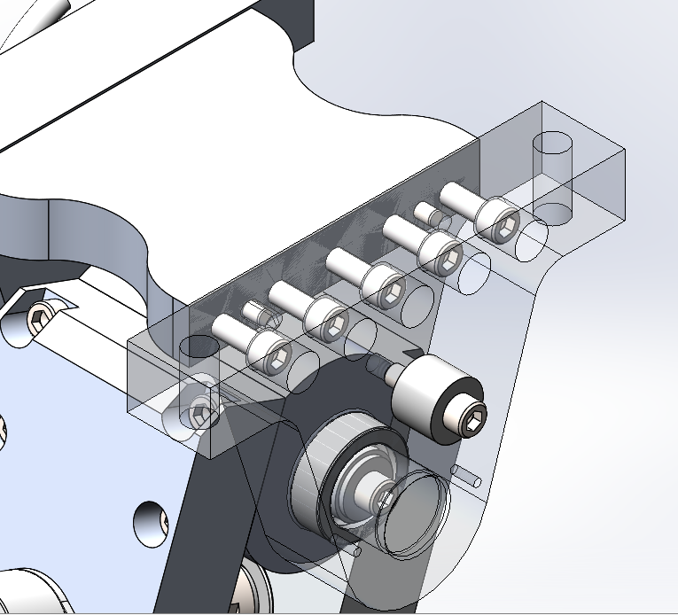
Upper Pivot
Each side of pivot plate is doweled into place.
4 Holes for attaching to cart or boom.
To be designed by Dillon Herbert for DOE or TBD for Manta Ray.
Mass of stationary upper pivot components is of minimal concern
Does not contribute to the dynamic response of the sensor.

Slide 9
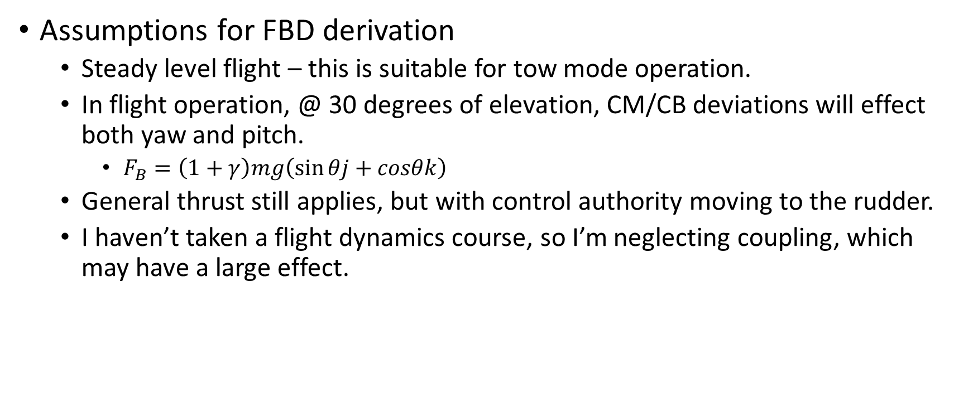
Center of Mass/Buoyancy Questions
Assumptions for FBD derivation
Steady level flight – this is suitable for tow mode operation.
In flight operation, @ 30 degrees of elevation, CM/CB deviations will effect both yaw and pitch.
$F_{B}=\left(1+γ\right)mg\left(\sin{θj}+cosθk\right)$
General thrust still applies, but with control authority moving to the rudder.
I haven’t taken a flight dynamics course, so I’m neglecting coupling, which may have a large effect.

Slide 10
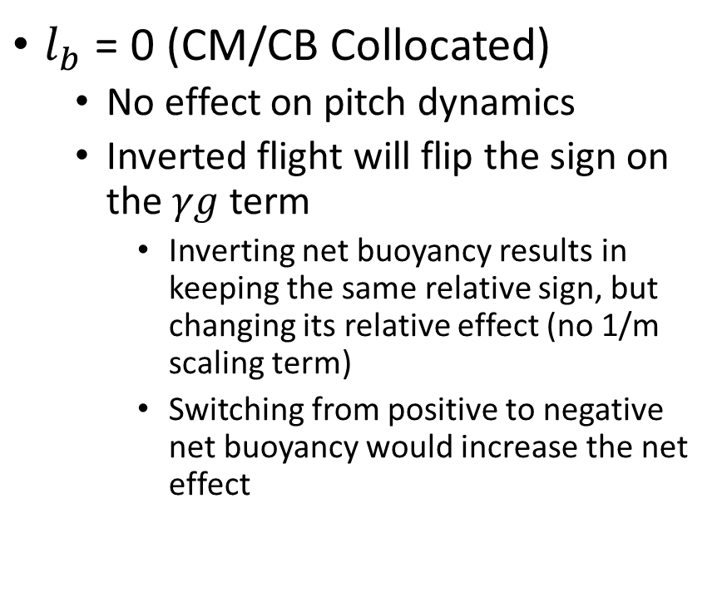
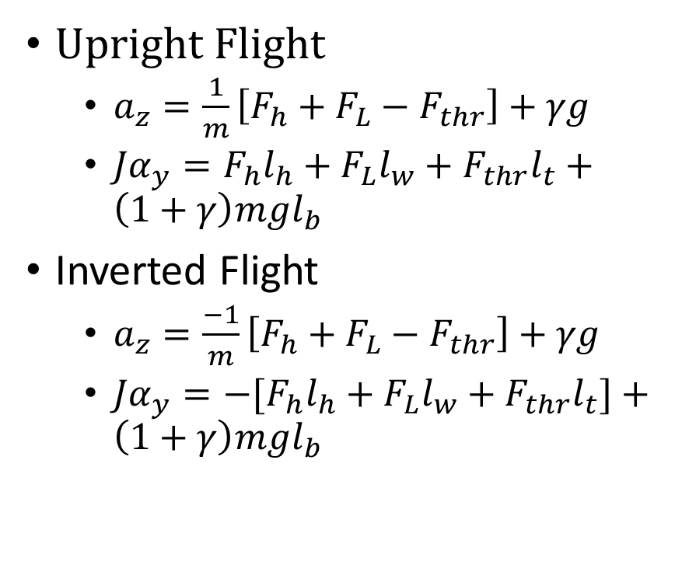
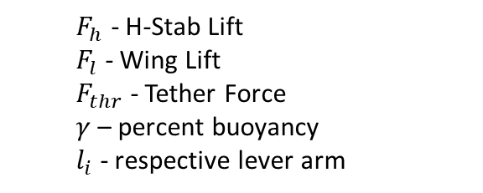
Center of Mass/Buoyancy Questions with regards to Upright vs Inverted Flight
Upright Flight
$a_{z}=\frac{1}{m}\left[F_{h}+F_{L}−F_{thr}\right]+γg$
$Jα_{y}=F_{h}l_{h}+F_{L}l_{w}+F_{thr}l_{t}+\left(1+γ\right)mgl_{b}$
Inverted Flight
$a_{z}=\frac{−1}{m}\left[F_{h}+F_{L}−F_{thr}\right]+γg$
$Jα_{y}={−[F}_{h}l_{h}+F_{L}l_{w}+F_{thr}l_{t}]+\left(1+γ\right)mgl_{b}$
$l_{b}$ = 0 (CM/CB Collocated)
No effect on pitch dynamics
Inverted flight will flip the sign on the $γg$ term
Inverting net buoyancy results in keeping the same relative sign, but changing its relative effect (no 1/m scaling term)
Switching from positive to negative net buoyancy would increase the net effect
$F_{h}$ - H-Stab Lift
$F_{l}$ - Wing Lift
$F_{thr}$ - Tether Force
$γ$ – percent buoyancy
$l_{i}$ - respective lever arm

Slide 11
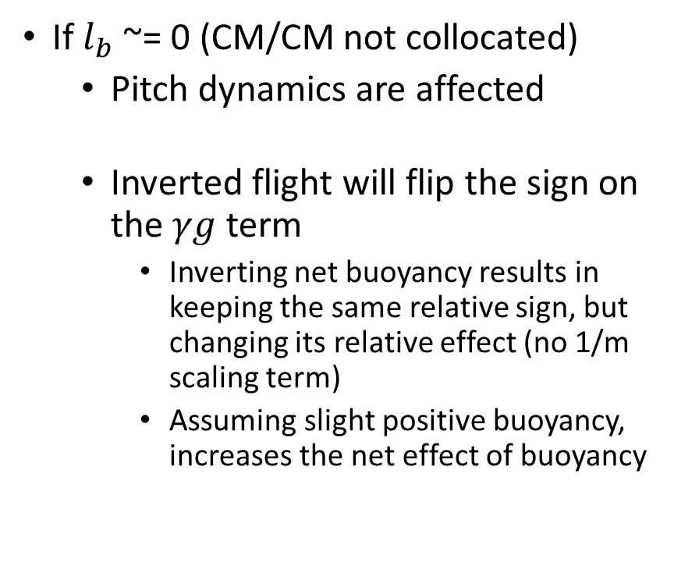
Center of Mass/Buoyancy Questions with regards to Upright vs Inverted Flight
Upright Flight
$a_{z}=\frac{1}{m}\left[F_{h}+F_{L}−F_{thr}\right]+γg$
$Jα_{y}=F_{h}l_{h}+F_{L}l_{w}+F_{thr}l_{t}+\left(1+γ\right)mgl_{b}$
Inverted Flight
$a_{z}=\frac{−1}{m}\left[F_{h}+F_{L}−F_{thr}\right]+γg$
$Jα_{y}={−[F}_{h}l_{h}+F_{L}l_{w}+F_{thr}l_{t}]+\left(1+γ\right)mgl_{b}$
If $l_{b}$ ~= 0 (CM/CM not collocated)
Pitch dynamics are affected
Inverted flight will flip the sign on the $γg$ term
Inverting net buoyancy results in keeping the same relative sign, but changing its relative effect (no 1/m scaling term)
Assuming slight positive buoyancy, increases the net effect of buoyancy
$F_{h}$ - H-Stab Lift
$F_{l}$ - Wing Lift
$F_{thr}$ - Tether Force
$γ$ – percent buoyancy
$l_{i}$ - respective lever arm

